Slide 1
Network Analysis using Wireshark
John McGarvey

Slide 2
Uses for Wireshark packet analysis
Identify poor network performance
Identify devices that drop packets
Validate optimal config of hosts
Analyse appl functionality and dependencies
Learn how TCP/IP works
Verify Appl security during launch, log and data transfer
Identify unusual network traffic indicating compromised hosts

Slide 3
Network Analysis
Listening to network traffic – packets
Used for
Performance issues
Security problems
Analyse Application behaviour
Capacity planning

Slide 4
Skills required to performance network/protocol analysis
Good understanding of TCP/IP
Ability to use Wireshark comfortably
Understand/know packet structures and packet flows
Why do we need DNS, DHCP and addressing?

Slide 5
Network traffic knowledge
All analysis done in Wireshark involves packets. In order to understand where a packet is coming from and going to you need to understand the various addresses involved
The Layer 2 – MAC/HW/Phy address – 48 bit-12 hex (6 for manu, 6 for ID)
The Layer 3 address – IP ,classes 32bit, standard practices, multicasts, broadcasts, network addresses

Slide 6
Some commonly used port numbers
20-21 FTP
23 Telnet
25 SMTP
42 WINS
43 Whois
53 DNS
67-68 – DHCP
69 TFTP
79 Finger
80 Http
102 MS exchange
110 Pop3
119 NNTP
139 NetBIOS
143 IMAP4
162 SNMP
383 HP openview
443 HTTP over SSL
514 Syslog
902 Vmware
1433/1434 – MS SQL
587 SMTP
691 – MS Exchange
6891 – 6901 MS Live
27015 – Halflife
31337 Back Orifice
33434 – traceroute
3689 – iTunes
Notes:
Dynamic port number >49000
What port number does ARP use?
What the function of the ffff.ffff.ffff MAC

Slide 7
Layer 2 - Switch
Forward packets(frames) based on dest MAC address in the frame header
Switch checks the frame for the correct checksum
If its incorrect(bad) its discarded
Rem switches have counters for errors, use the show int f0/? to view
If checksum is good check MAC table to find port no, else broadcasts

Slide 8
L3 - Routers
Change the dest MAC to the target if local or to the next router address if the address is remote(on another network)
Firewalls examine and filter packets based on L3 addresses and L4 addresses(port numbers)
NAT alters IP addresses from an internal IP to an external IP, PAT alters port information
To identify communications you’ll need to look past the NAT/PAT info contained in the IP header

Slide 9
Other Tech that affects packets
VLANs – tagging adds vlan tags to the frame, a vlan is a way of logically breaking up a network based on MAC/IP, port no, etc.
MPLS – multi protocol label switching is a method of creating virtual links between remote hosts. MPLS adds a header for use by MPLS edge devices
MPLS uses this info for forwarding packets NOT routing tables

Slide 10
9 GUI items on Wireshark
Title
Menu
Main Toolbar
Filter Toolbar
Wireless Toolbar
Packet List Pane
Packet Details Pane
Packet Byte Pane
Status Bar

Slide 11
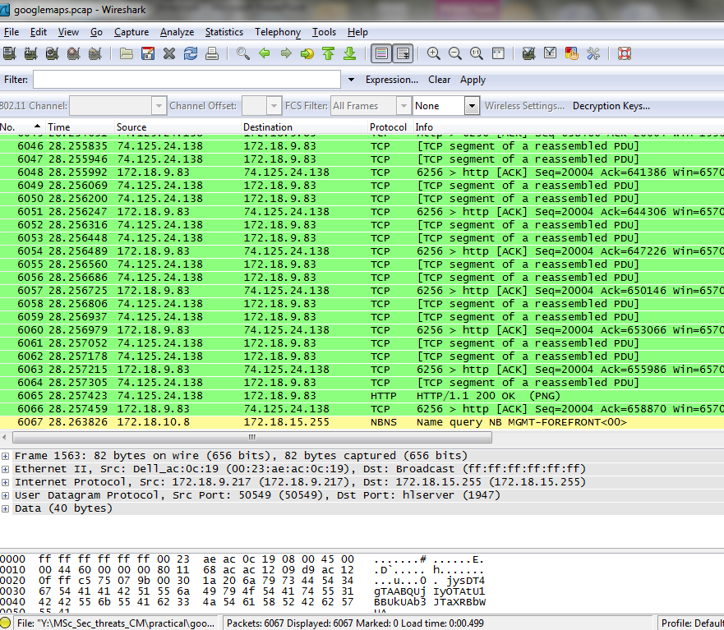
1
2
3
4
5
6
7
8
9

Slide 12

Starting the capture
To start capturing an interface select capture interfaces and hit start
When your starting a capture it is important to have the application/service running or ready to start
Depending on the device your using you may have a range of interfaces to select from

Slide 13

Your first capture
You’ll need to stop the capture and then save the pcap file.
NB A pcap file running for longer than 30 seconds may generate over 10,000 packets depending on services apps running.
You may want to flush your DNS on your machine before starting a capture to get the full picture – use ipconfig /flushdns

Slide 14
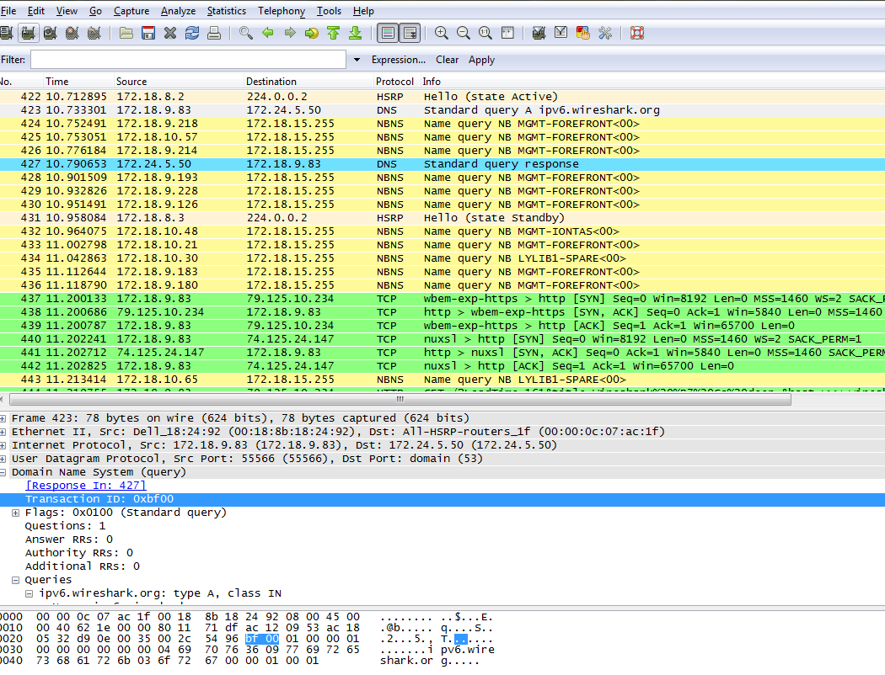
A simple wireshark capture

Slide 15
Now tell the story
Identify the hosts(ip addr) that you are connecting with
Note the sequence of the packets
You should see a DNS query and a response
Followed by a connection to the wireshark webserver
You should note the Acknowledgements from client to server
Note the HTTP Get Request
Other things to note is the traffic from other applications and Services

Slide 16
Case Study 1 - Pruning the “Puke”
Frederick County Public Schools – Mitch Dickey
24 buildings
50 VLANs
Each campus 2 vlans one for voice one for data
Netware environment – 1 Netware server per campus
Wireshark is used to remove unnecessary traffic from the VLANs

Slide 17
Case Study 1 - Cleaning up the trace
Remove all SMB and NetBIOS traffic, NetWare uses NDPS and don’t require the Microsoft File and Printer Sharing
Other VLANs out of Mitch’s control were captured. These stats were collected:-
50,800 packets – 1321 are NetBIOS 2.5%
175,000 packets – 16480 are NetBIOS 9%
295,000packets – 14102 are NetBIOS 5%
Other unnecessary protocols may be removed also SNMP and SSDP

Slide 18
Case Study 2 - Securely Invisible
22 buildings in campus style
Complaint from Management is that network was slow at times
Consultant (Net analyst) is asked to sign a legal doc about not listen to network traffic to isolate the problem – concern was that confidential data may traverse the network
Management were ignorant of the fact that there are many other ways to tap into the network

Slide 19
Case Study 2 - Securely Invisible
It would be better to verify and fix the problem rather than assume “no one is listening”
After convincing them to analyse the traffic it was evident that
Lotus Notes was misconfigured and sending emails as clear text across the network
There were several applications sending sensitive data across the network
Security enhancements were suggested upon completion

Slide 20
Why we do network packet analysis
The only way to diagnose performance issues is by examining network traffic
Guessing which applications or services is causing trouble can be inaccurate and cost the company time and money
A full understanding of network traffic flow is required to
Capture the packets in the right area of the network
Identify the cause of the network problems

Slide 21
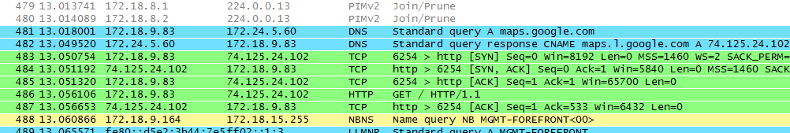
Google maps example
If we examine a capture called googlemaps we see the usual DNS queries, we also see that maps.google.com’s real name(CNAME) is maps.1.google.com – pkt 481,482
TCP connection is est – 483,484,485
Uses GET HTTP for main page, 486
Notes:
CNAME – DNS canonical name

Slide 22
Conversations and Endpoints
A Conversation is a pair of devices communicating with each other
An Endpoint is one side of this communication
172.18.9.83 and 74.125.24.102 are communicating(http)
172.18.9.83 and 74.125.24.102 are the endpoints
Very useful when dealing with large files and identifying most active hosts

Slide 23
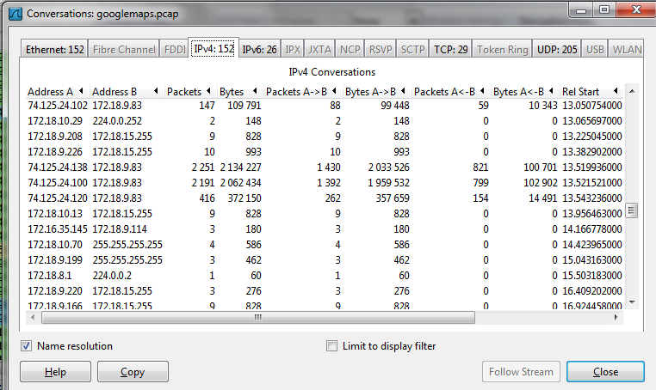
Conversations
From the menu select Statistics – Conversations
Here we can see 74.125.24.138 sent 2 million bytes to 172.18.9.83
Notes:
ip.addr==74.125.24.138 && ip.addr==172.18.9.83 filter for conversation

Slide 24
Packet lengths & IO graphs
An important characteristic in any data transfer process
Transferring a large file using small packets is not as efficient as using full size packets – why?
IO graphs

Slide 25
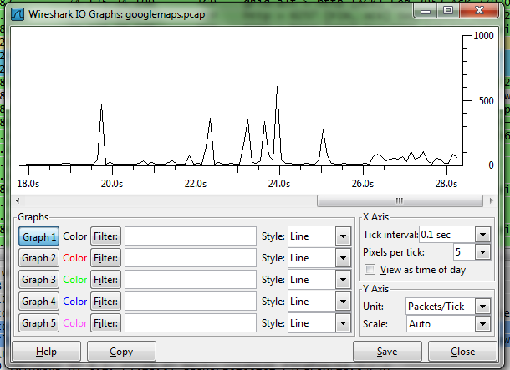
IO Graphs
May be performed on live or saved captures
You can jump to specific bursts of traffic easily and get an overview of the conversation
A basic IO graph

Slide 26
Graphs
Use graphs 1 to 5 to clearly define the various types of traffic based on filters
Each graph has a different colour to highlight the traffic

Slide 27
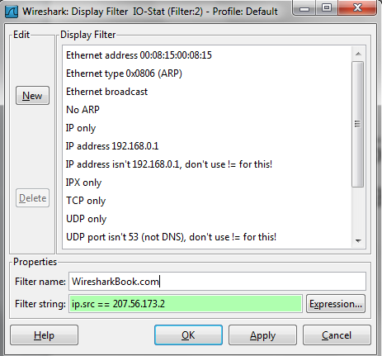
Filters within IO graphs
Always use a filter name where possible
In this case we want to isolate traffic from wiresharkbook

Slide 28
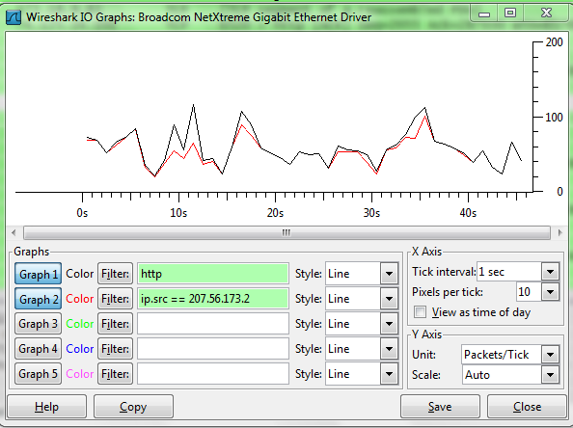
Filtering traffic
Black Line = Web traffic all http traffic
Red Line = 207.56.173.2
The wiresharkbook webserver

Slide 29
Wireshark – 1_simple.pcap
What colour are DNS packets and TCP packets
What is the IP address of the Wireshark webserver
What is the IP address of my PC?
What is the physical address of my PC?
What is the MAC address of the DNS server?

Slide 30
Task two
Open a file called MSc_second.pcap
Answer the following questions
What packet number was a request made?
Where did the bulk of the (HTTP)packets come from?
How many packets were used for this transaction
What kind of packet was sent back every 3rd packet
Notes:
22291 – 65 roughly

Slide 31
Review
For further info on Wireshark fundamentals read chapters 1 and 2 of Laura Chappell’s Book on wireshark.
https://www.youtube.com/watch?v=UXAHvwouk6Q – Laura Chappell 2013 Sharkfest link. Very good video

